Slide 1
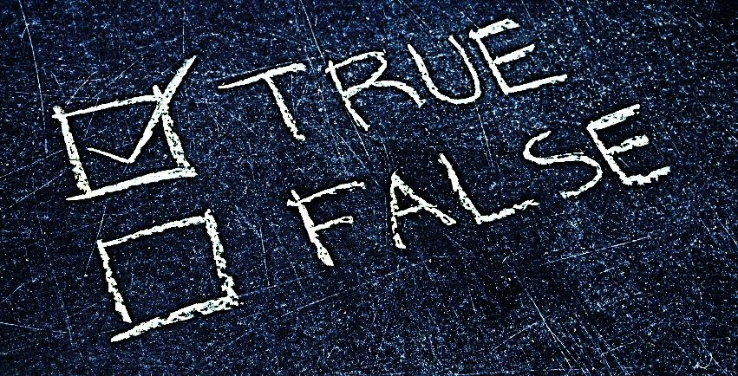
Ten Truths about Jesus Christ & Salvation (Christ: The Savior foretold in the Hebrew scriptures)

Slide 2
Note: Any videos in this presentation will only play online. After you download the slideshow, you will need to also download the videos from YouTube & add them back into your PowerPoint.
We present these messages at Bee Creek Park in College Station, TX. If you would like to watch the video of the service with this message, click here:
http://campaignkerusso.org/?p=10863
We would love to know more about the people who download our lessons & sermons. We invite you to email us & let us know where & how you use them.
info@ckbrazos.org

Slide 3
Next Slide - Song: Every Knee Shall Bow Download Here: http://youtu.be/fQUq5rwodVo

Slide 4
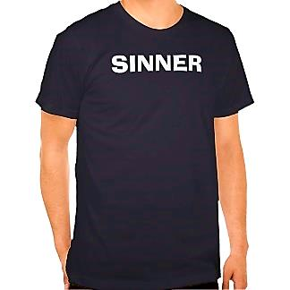
Truth #1: All people sin.

Slide 5
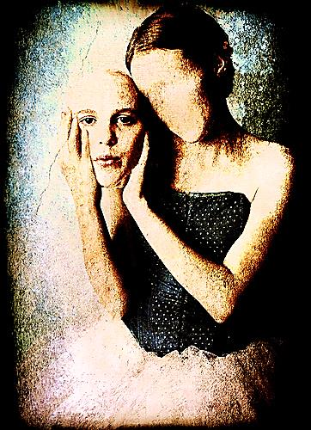
False: Some people are good people.

Slide 6
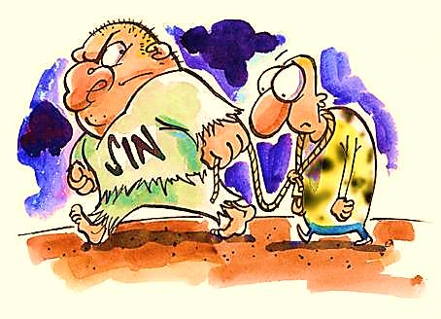
Verse: “…the whole world is under the power of sin.” Galatians 3:22

Slide 7
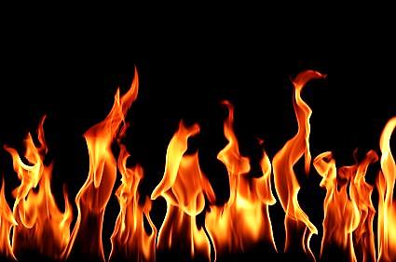
Truth #2: The penalty for sin is separation from God and death both now and forever.

Slide 8
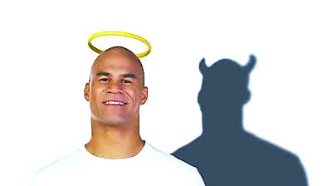
False: Only the “bad people” will suffer eternal death and damnation.

Slide 9
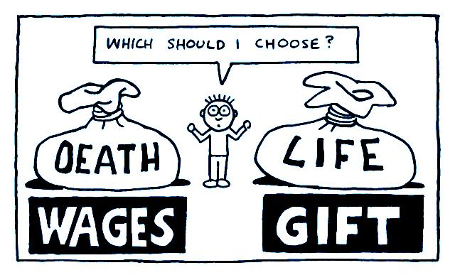
Verse: “You get what is coming to you when you sin. It is death!
But God’s free gift is life that lasts forever. It is given to us by our Lord Jesus Christ.” Romans 6:23

Slide 10
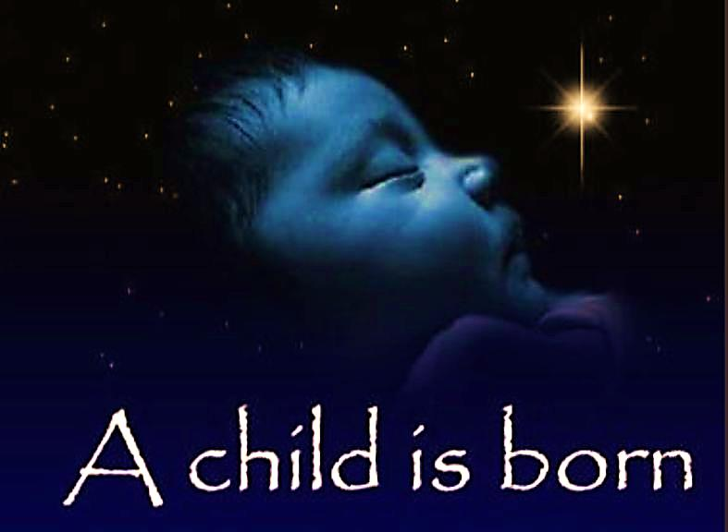
Truth #3: Jesus Christ is God who, because of His love for us, became a man so that, as a man, He could be punished (by death) in our place.

Slide 11
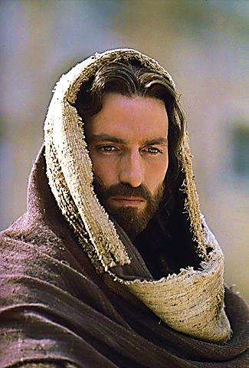
False: Jesus Christ was merely a good man, a moral teacher, an angel or a messenger of God.

Slide 12
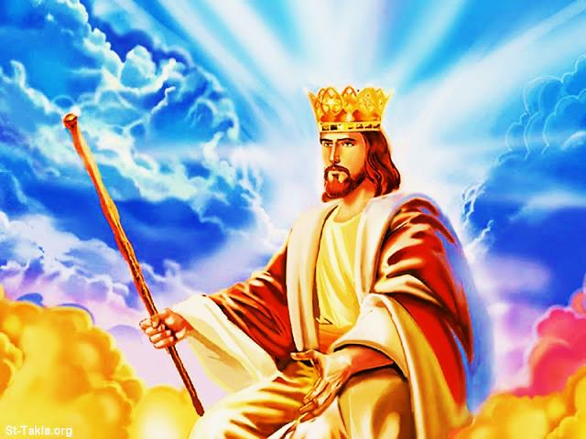
Verse: “For to us a Child will be born. To us a Son will be given. And the rule of the nations will be on His shoulders. His name will be called Wonderful, Teacher, Powerful God, Father Who Lives Forever, Prince of Peace.” Isa. 9:6

Slide 13
Truth #4: Because of love, Jesus Christ shed his blood to pay the death penalty which we owe for our sin.

Slide 15
False: Jesus did not really die.

Slide 17
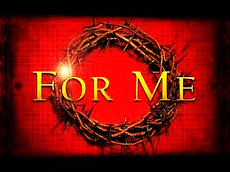

Slide 18
False: Man can do good works to pay for his own sins.

Slide 19
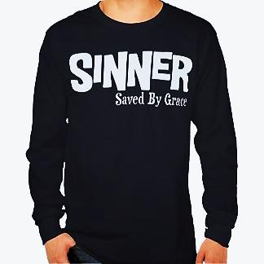
Verse: “For God did not send His Son into the world to say it is guilty.
He sent His Son so the world might be saved from the punishment of sin by Him.”
John 3:17

Slide 20
Truth #5: The blood of Jesus Christ is the only acceptable payment for our sins.

Slide 21
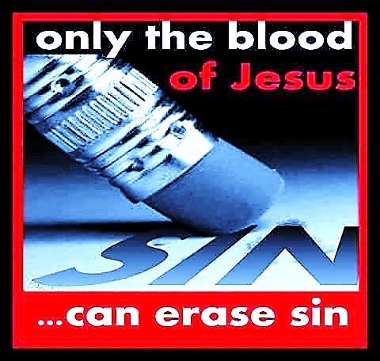

Slide 22
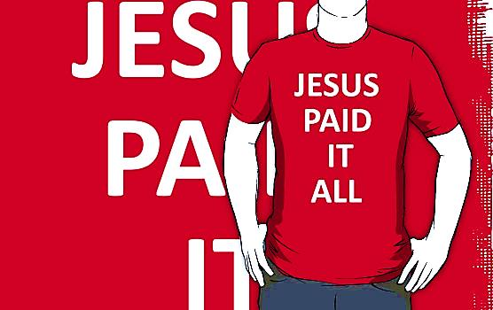

Slide 24
False: Good works, good thoughts and religious rituals will satisfy God’s holiness and His righteous justice.

Slide 25
Verse: “Because of the blood of Christ, we are bought and made free from the punishment of sin. And because of His blood, our sins are forgiven.” Ephesians 1:7

Slide 26
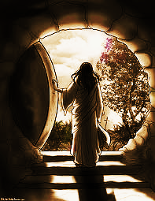
Truth #6: Jesus Christ was buried and the Father raised Him bodily from the dead on the third day.

Slide 27
Very Dangerous
False Teachings
Jesus Christ is not the fullness of God in a human body.
Jesus Christ never died.
Jesus Christ was never buried.
Jesus Christ’s body never rose from the dead.
These are dangerous teachings because if any of these were true, we would still be under penalty of death for our sins.

Slide 28
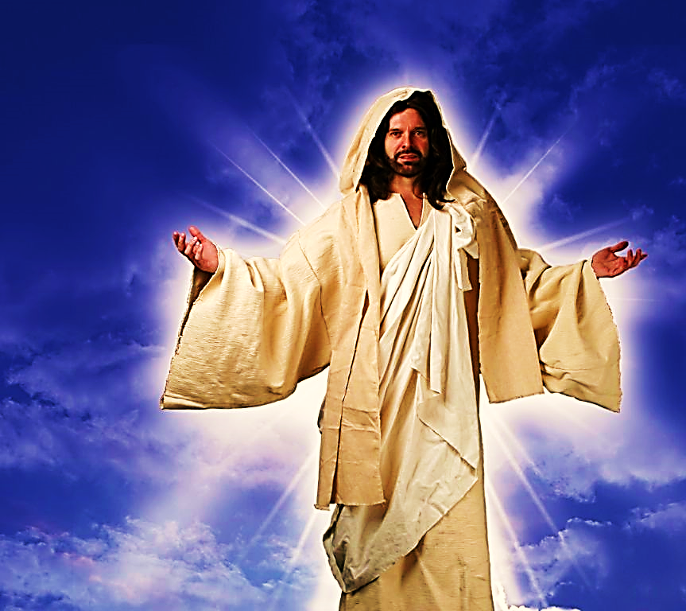
Verse: “I am the Living One. I was dead, but look, I am alive forever.
I have power
over death
and hell.”
Revelation 1:18

Slide 29
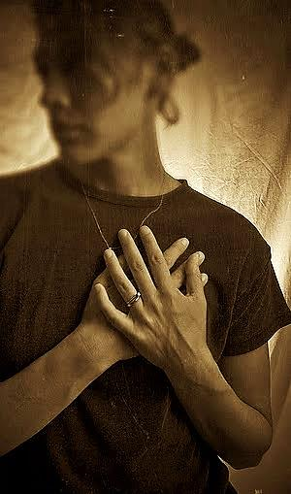
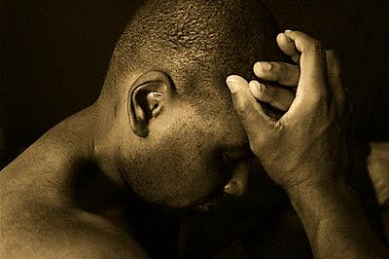
Truth #7: We must be sorry for our sins and ask Jesus to forgive & save us.

Slide 30
False: As long as our good works exceed our sins, God will be satisfied with our goodness.

Slide 31
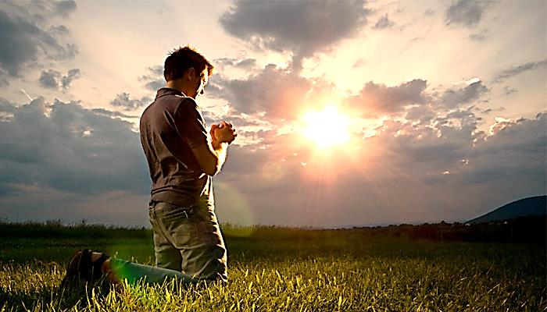
Verse: “Wash your hands, you sinners. Clean up your hearts… Be sorry for your sins and cry because of them. Be sad and do not laugh. Let your joy be turned to sorrow. Let yourself be brought low before the Lord. Then He will lift you up and help you.” James 4:8-10

Slide 32
Truth #8: When we ask Jesus Christ to save us, He will cause us to be reborn as a child of God.

Slide 34
False: We can better ourselves.

Slide 35
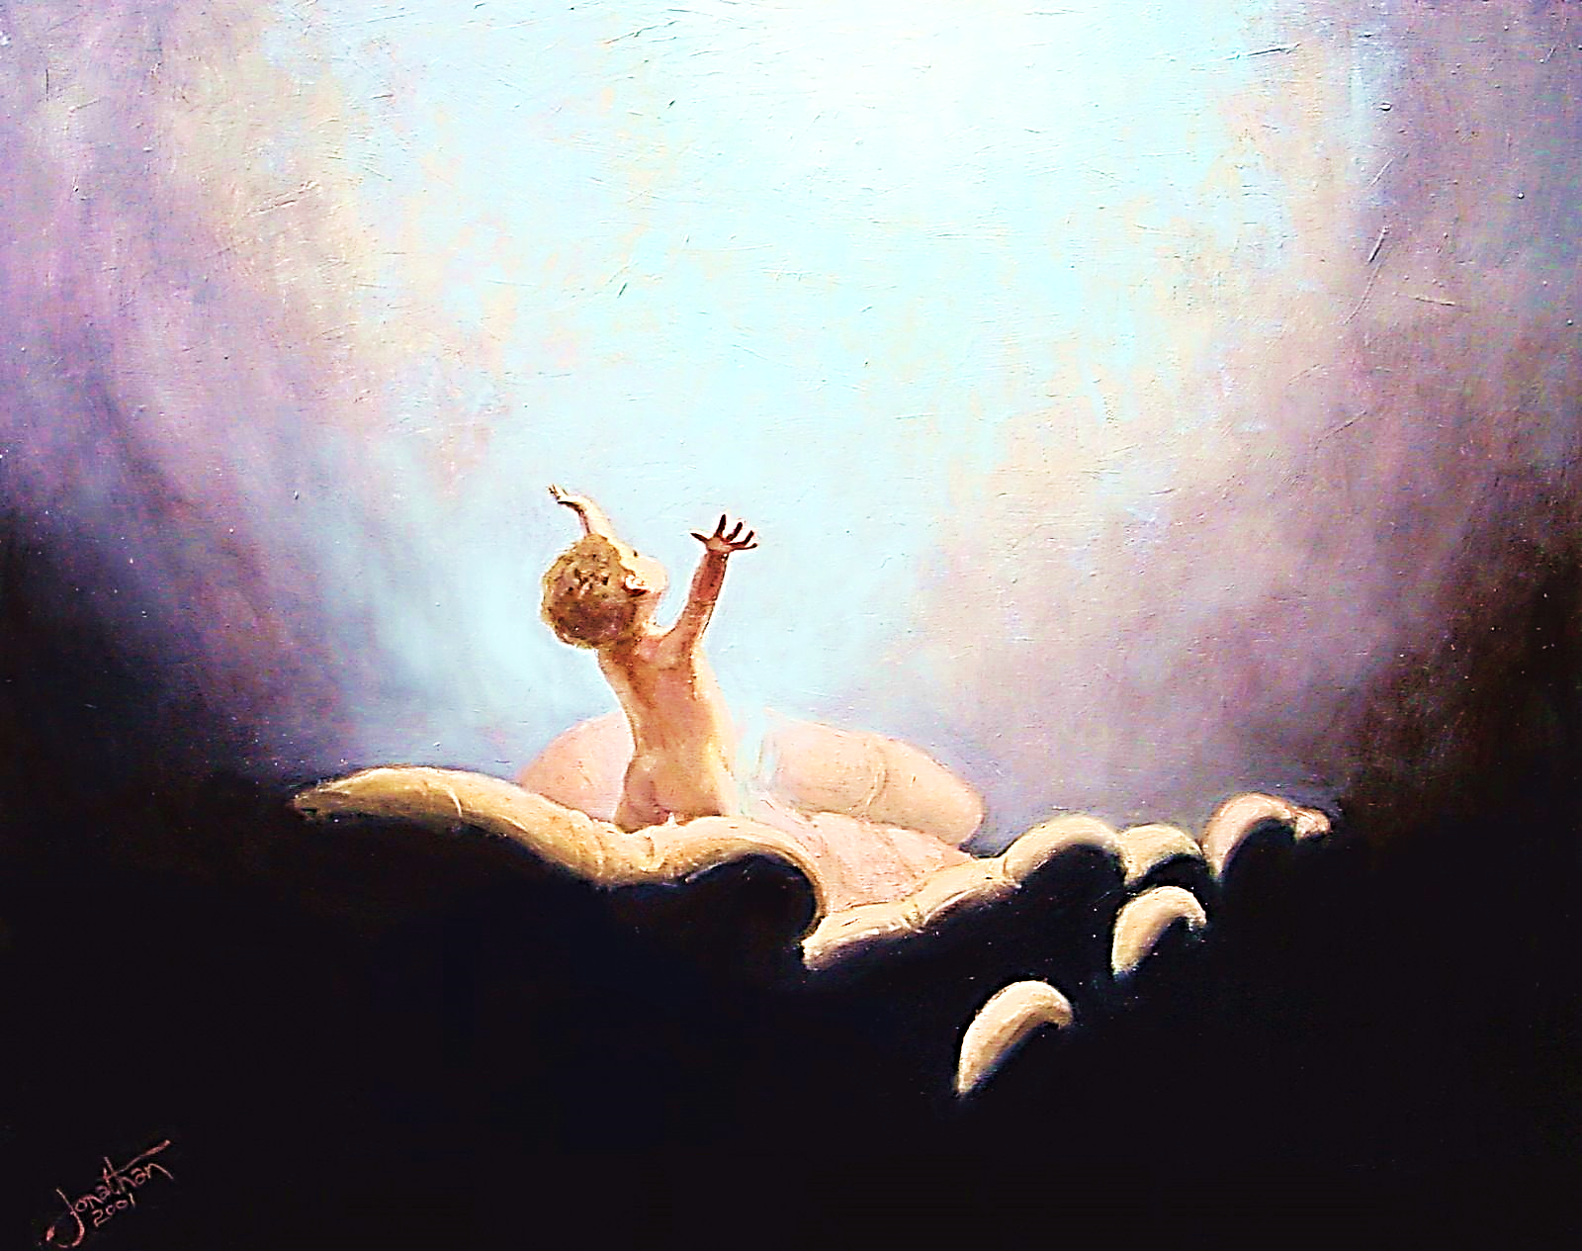
Verse: “He gave the right and the power to become children of God to those who received Him. He gave this to those who put their trust in His name.” John 1:12

Slide 36
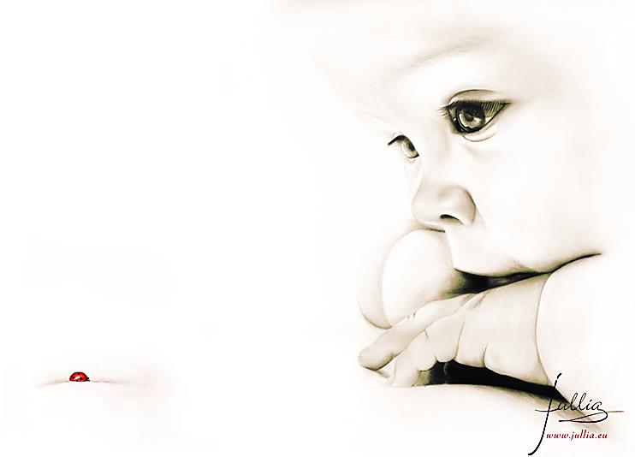
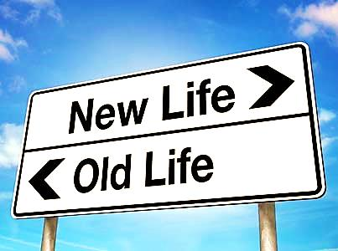

Slide 37
Truth #9: Salvation requires faith plus nothing!
Our good works cannot save us, only faith in the death and resurrection of Jesus Christ can save us.

Slide 38
Verse: “But God, the One Who saves, showed how kind He was and how He loved us by saving us from the punishment of sin.
It was not because we worked to be right with God. It was because of His loving-kindness that He washed our sins away.
At the same time He gave us new life when the Holy Spirit came into our lives.” Titus 3:5, 6

Slide 39
Truth #10: All that matters is receiving God’s free gift of salvation which was paid for by the blood of Jesus Christ.

Slide 40
False: Good works, good intentions and religious rituals cleanse us and impress God.

Slide 41
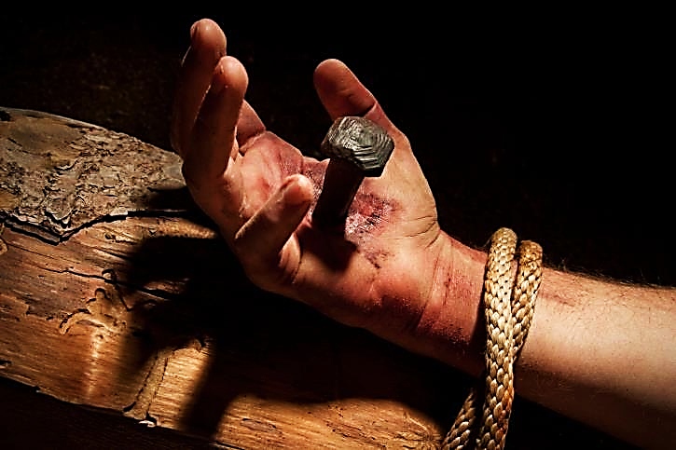
Verse: “Jesus Christ is the first to be raised from the dead. He is the head over all the kings of the earth. He is the One Who loves us and has set us free from our sins by His blood.”
Revelation 1:5

Slide 42
Next Slide - Song: Thank You for Loving Me Download Here: http://youtu.be/pL2mEoPTBnA

Slide 43
Is Jesus Speaking to You?
“They said to each other, ‘Did not our hearts burn within us while he talked to us on the road, while he opened to us the Scriptures?’”
John Wesley Said:
“…the preacher was describing the change which God works in the heart through faith in Christ and I felt my heart strangely warmed.”
Jesus makes His presence Known by a small voice!

Slide 45
What is the Sinner‘s Prayer?
This is a prayer we can pray when we are ready to admit we are sinners and need Christ’s forgiveness.
It must be prayed with faith in our hearts and a readiness to have a life-changing encounter with Jesus Christ.

Slide 46
A prayer of faith → Pray this prayer if :
If you never have before
You have in the past, but you think it would mean more today
You have been walking afar off and you want to come back
You want to set an example & show others how it is done
You just like to give your heart to Jesus again & again
Faith

Slide 47
We Declare Our Faith Publicly Because Jesus Declared His LOVE Publicly
“If you stand before others and are willing to say you believe in me, then I will tell my Father in heaven that you belong to me.” Mat 10:32

Slide 48
Important Questions
Do you want to know Jesus as your Savior right now?
Do you believe He died to save you from your sins & that He rose from the dead?
Do you believe that He is here, waiting to save you right now?

Slide 49
The Prayer of a Sinner Turning to Jesus
Dear Jesus, I know that I have sinned against You and that my sins separate me from You.
I am truly sorry.
Right now, I turn away from my sinful past .
Please forgive me, and help me to keep from sin.
I believe You died for my sins.
I Believe You rose from the dead, you are alive, and you hear this prayer from my heart.
I invite You Jesus to be both my Savior and the Lord of my life.
I want You to rule my life from now on.

Slide 50
“But some people did accept him. They believed in him, and he gave them the right to become children of God.”
John 1:12

Slide 52
“If you openly say, ‘Jesus is Lord’ and believe in your heart that God raised him from death, you will be saved.”
Rom. 10:9
What did you learn today?
What is the meaning of the name-tag?
What have you been thinking about God lately?
What do you want to tell the world about Jesus?

Slide 53
“Draw near to God, and He will draw near to you…
Altar Time
…Cleanse your hands, you sinners, and make your hearts pure, you who are half-hearted towards God.” James 4:8 WNT

Slide 54
Close in Prayer

Slide 55
Note: Any videos in this presentation will only play online. After you download the slideshow, you will need to also download the videos from YouTube & add them back into your PowerPoint.
We present these messages at Bee Creek Park in College Station, TX. If you would like to watch the video of the service with this message, click here:
http://campaignkerusso.org/?p=10863
We would love to know more about the people who download our lessons & sermons. We invite you to email us & let us know where & how you use them.
info@ckbrazos.org

Slide 56
Welcome to Aggieland Faith Family Style Worship

Slide 57
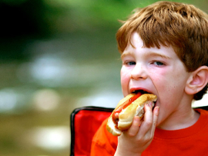
CURRENT SCHEDULE: See www.Aggielandfaith.org
SUNDAY —
At Bee Creek Park
2:00-5pm: Free snacks, drinks, kids crafts, prizes, singing & bible preaching

Slide 58
Would You Like Prayer or Bible Study at Your House?
Personal Prayer: We can come to your home & pray with you, or you can email us when you need prayer.
Home Bible Study: We will come to your home & hold a bible study for you & your friends.
Bible Party: We will hold a Kid’s Bible Party: You provide the food & kids - we will do the bible fun & stories.

Slide 59
Would You Like Visitation?
We will visit a friend, loved one in the hospital or in prison to pray for them & share Christ with them.
Contact: info@aggielandfaith.org

Slide 60
www.aggielandfaith.org
Go here to see pictures & videos
Go here to subscribe to e-mails about changes & cancellations

Slide 61
Note: Any videos in this presentation will only play online. After you download the slideshow, you will need to also download the videos from YouTube & add them back into your PowerPoint.
We present these messages at Bee Creek Park in College Station, TX. If you would like to watch the video of the service with this message, click here:
http://campaignkerusso.org/?p=10863
We would love to know more about the people who download our lessons & sermons. We invite you to email us & let us know where & how you use them.
info@ckbrazos.org

